Slide 1
Computer Vision and Deep Learning
Lecture 4

Slide 2
Today’s agenda
Short history of of neural networks
Convolutional neural networks
How to evaluate a classifier

Slide 3
Classifier evaluation

Slide 4
Train, dev and test sets
Training set
Used to train the model, determines what the network learns
Development (dev) set or validation set
Used to evaluate the performance of your models and determine which ones work best
Test set
Used to get an unbiased estimate of the final performance of the model
Sometimes is might be ok to not have a test set (only train and dev sets)

Slide 5
How to split your data into train/dev/test set?
Before deep learning, when available data was relatively limited (e.g. 10000 images)
70 % train
30 % dev
7000 train, 3000 dev
60 % train
20% test
20% dev
6000 train, 2000 dev,
2000 test

Slide 6
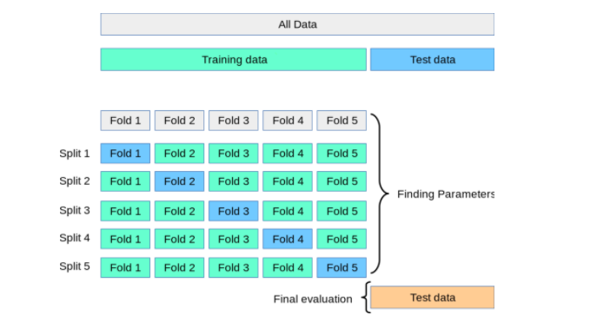
K-fold validation

Slide 7
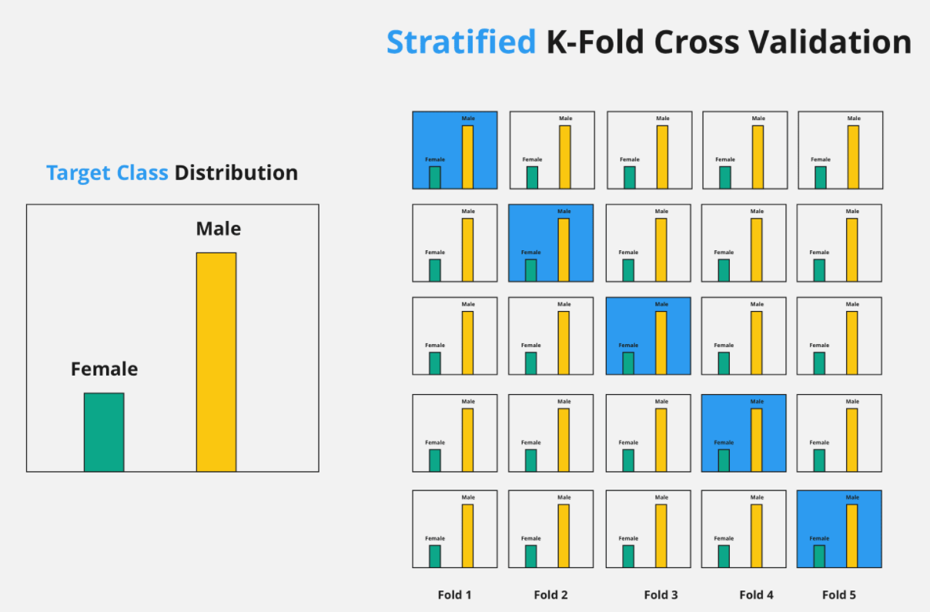
Stratified k-fold validation

Slide 8
How to split your data into train/dev/test set?
Large scale datasets
ImageNet > 14 million images
VGGFace 2 > 3.3 million images
JFT > 300 million images
E.g. 1 million images
980000 train set, 10000 dev set, 10000 test set -> 98% train, 1% dev, 1% test
E.g. 4 million images
3980000 train set, 10000 dev set, 10000 test set -> 99.5% train, 0.25% dev, 0.25% test

Slide 9
Convolutional neural networks

Slide 10
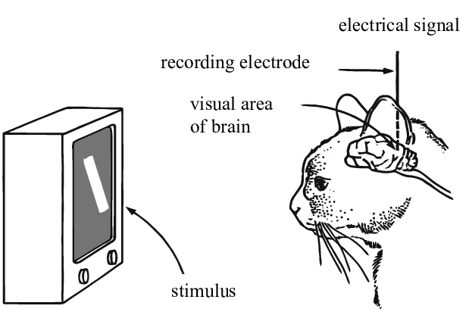
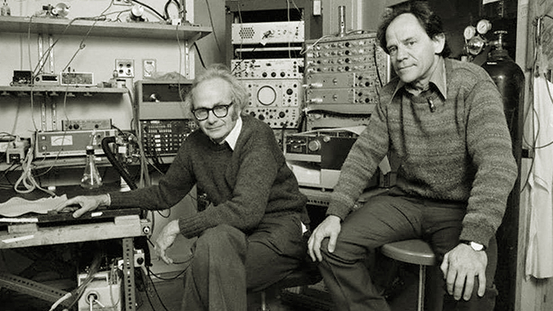
Understanding the visual cortex
Nobel Prize for Physiology or Medicine in 1981:
David Hubel and Torsten Wiesel
Simple cells:
orientation, position
Complex cells:
orientation, motion, direction
“Hypercomplex” cells:
orientation, motion, direction, length
Hubel and Wiesel, 1959
https://www.youtube.com/watch?v=IOHayh06LJ4&ab_channel=PaulLester
Image source: https://www.researchgate.net/publication/335707980_Understanding_Neural_Networks_via_Feature_Visualization_A_Survey

Slide 11
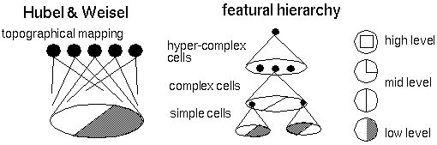
Understanding the visual cortex
Nearby cells in the cortex represented and processed nearby regions in the visual field
Hubel and Wiesel hypothesized that the visual cortex can be described by a hierarchical organization of simple cells that fed into complex cells which have more complicated activations and can form higher level representations
https://peterkim95.github.io/jekyll/update/2017/08/29/introspectiveness-of-nn/

Slide 12
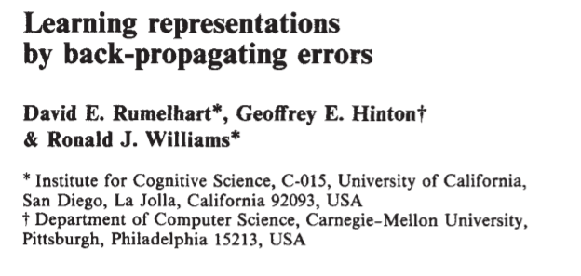
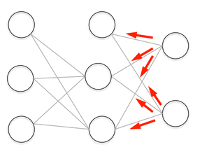
Backpropagation, 1986

Slide 13
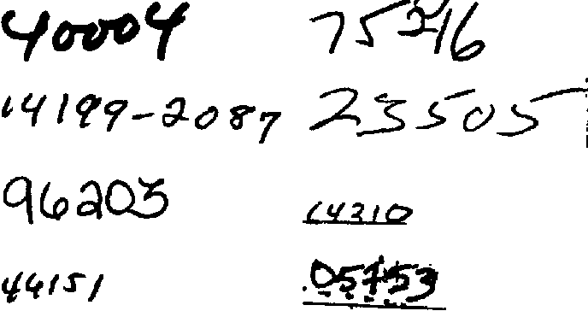
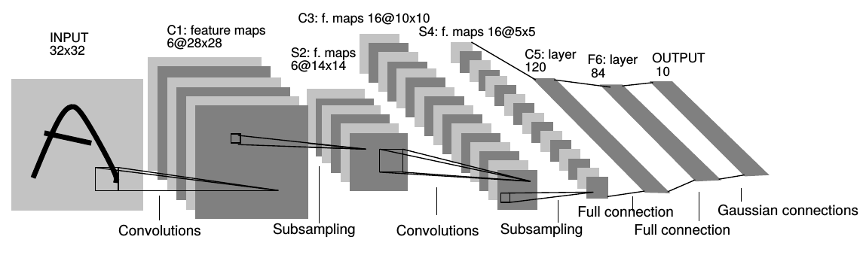
Gradient-Based Learning Applied to Document Recognition, Yann LeCun, Leon Bottou, Yoshua Bengio, and Patrick Haffner, 1998
1989 – the original form of LeNet

Slide 14
Deep Big Simple Neural Nets Excel on Handwritten Digit Recognition Dan Ciresan, 2010
One of the very fist implementations of GPU Neural nets
forward and backward pass implemented of an artificial neural network (up to 9 layers) implemented on an NVIDIA GTX 280 graphic processor

Slide 15
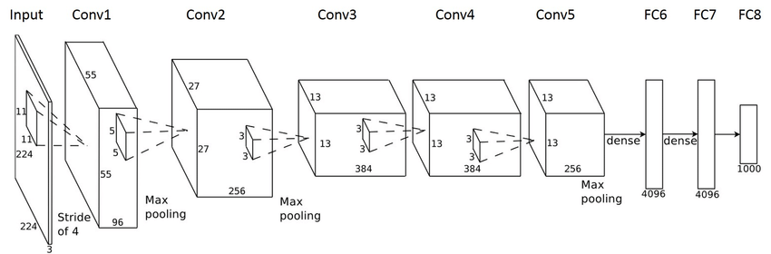
ImageNet Classification with Deep Convolutional
Neural Networks, Alex Krizhevsky, Ilya Sutskever, Geoffrey E. Hinton
2012

Slide 16
Convolutional neural networks

Slide 17
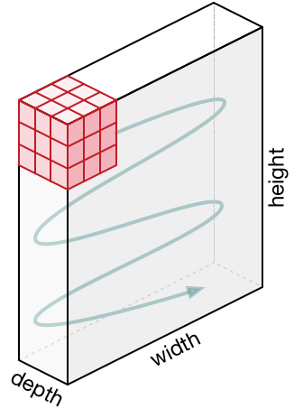
Convolutional layers
Preserve the spatial information
Convolve the filter over the entire input volume
The filter has the same depth as the input
filter
5x5x3
Input volume
32x32x3
Activation map
28x28x1

Slide 18
Convolutional layers
Preserve the spatial information
Convolve the filter over the entire input volume
The filter has the same depth as the input
At each position in the input volume:
Multiply (element-wise, across all channels) the filter and a small patch (5x5x3) in this input volume and add a bias term
filter
5x5x3
Input volume
32x32x3
Activation map
28x28x1

Slide 19
Convolutional layers
Preserve the spatial information
Convolve the filter over the entire input volume
The filter has the same depth as the input
k filters
Input volume
32x32x3
k activation maps
28x28x1

Slide 20
Convolutional layers
Neurons in an activation map:
Each neuron is connected to a small region in the input
All of neurons in the activation map share parameters
Receptive field of a neuron
k filters → k different neurons all looking at the same region in the input volume
k activation maps
28x28x1

Slide 21
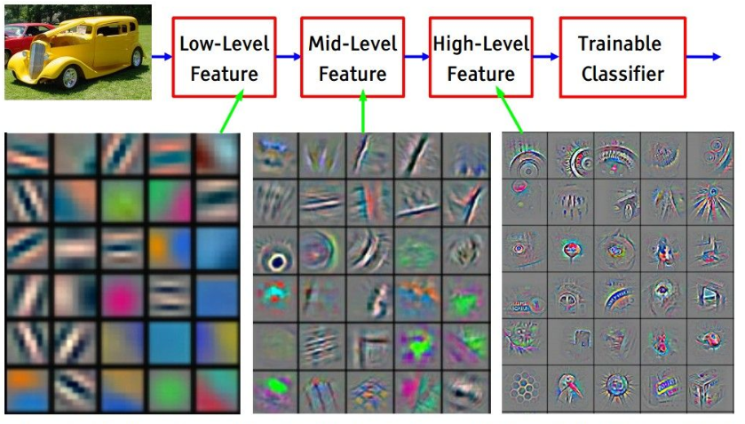
https://medium.com/@chriskevin_80184/feature-maps-ee8e11a71f9e
https://www.youtube.com/watch?v=AgkfIQ4IGaM

Slide 22
Convolutional layers Stride
Stride – the amount by which the filter shifts
Stride 1

Slide 23
Convolutional layers Stride
Stride – the amount by which the filter shifts
Stride 2

Slide 24
Convolutional layers Padding
0 | 0 | 0 | 0 | 0 | 0 | 0
0 |  |  |  |  |  | 0
0 |  |  |  |  |  | 0
0 |  |  |  |  |  | 0
0 |  |  |  |  |  | 0
0 |  |  |  |  |  | 0
0 | 0 | 0 | 0 | 0 | 0 | 0
Convolve an input of spatial size 7x7 with a 3x3 filter : output spatial size?
Convolve an input of spatial size 7x7 with a 3x3 filter, and applying 0 padding to the input: output spatial size?
To preserve size spatially:
CONV layers with stride 1, filters of size FxF, and zero-padding with (F-1)/2
padding: 1

Slide 25
Why convolutions
Parameter sharing
A feature detector that’s useful in one part of an image is probably useful in other parts of the image
Translation invariance
Sparsity of connections
The output volume depends only on a small (filter size) subset of the input volume

Slide 26
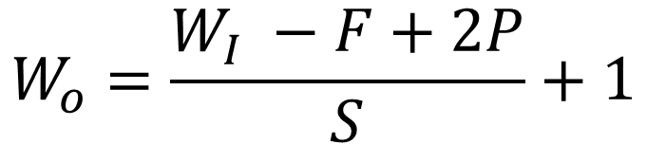
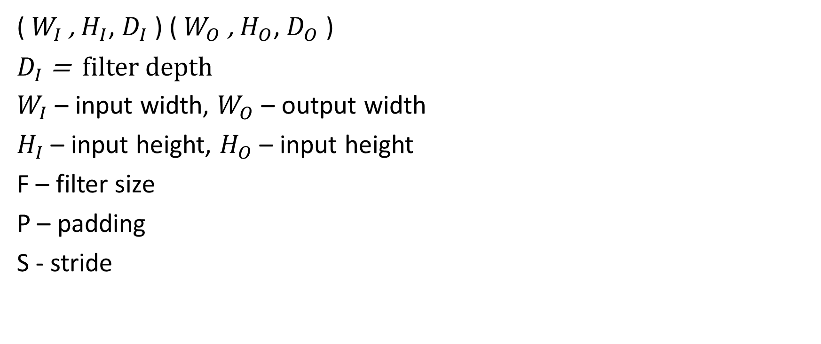
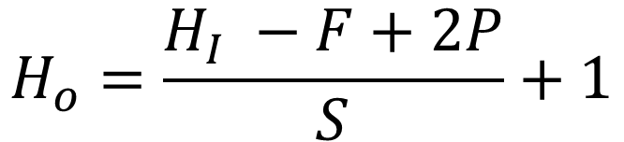
Convolutional layers
($W_{I}$ , $H_{I}$, $D_{I}$ ) ($W_{O}$ , $H_{O}$, $D_{O}$ )
$D_{I}$ = filter depth
$W_{I}$ – input width, $W_{O}$ – output width
$H_{I}$ – input height, $H_{O}$ – input height
F – filter size
P – padding
S - stride
$$W_{o}=\frac{W_{I} −F+2P}{S}+1$$
$$H_{o}=\frac{H_{I} −F+2P}{S}+1$$

Slide 27
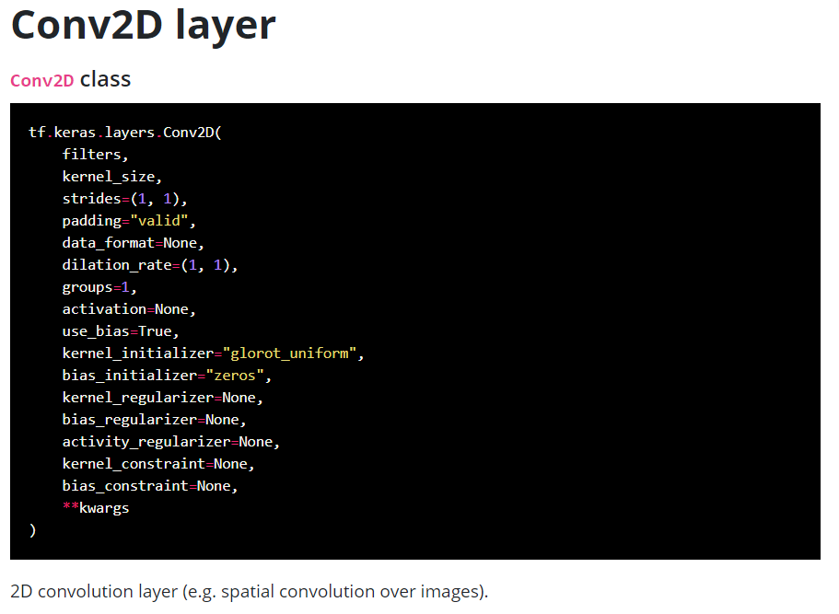
Padding: “same” or “valid”

Slide 28
Pooling layers
Operate independently over each channel in the input
Reduces the input size, creating smaller (and more manageable) representations
Common pooling layers:
max pooling: takes the maximum value within each “patch” in the feature map
average pooling: takes the average value of each “patch” in the feature map
It does not contain any learnable weights

Slide 29
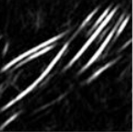
Pooling layers
Operates independently over each channel
Pooling – reduces spatial dimension

Slide 30

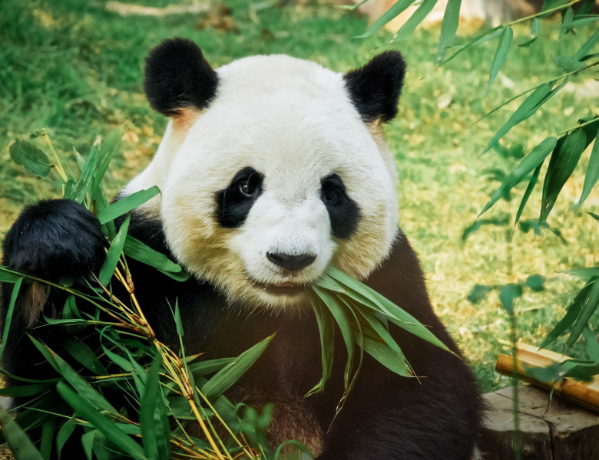

Pooling layers Examples
Max pooling
Avg pooling

Slide 31
Pooling layers Example: max pooling layer, F 2, stride 1
1 | 3 | 6 | 6
20 | 9 | 8 | 4
2 | 1 | 4 | 5
1 | 12 | 13 | 10
20 | 9 | 8
20 | 9 | 8
12 | 13 | 13

Slide 32
Pooling layers Example: max pooling layer, F 2, stride 2
1 | 3 | 6 | 6
20 | 9 | 8 | 4
2 | 1 | 4 | 5
1 | 12 | 13 | 10
20 | 8
12 | 13

Slide 33
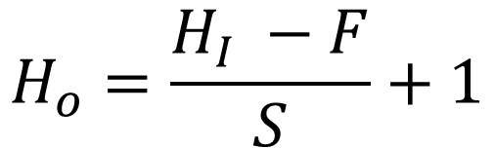
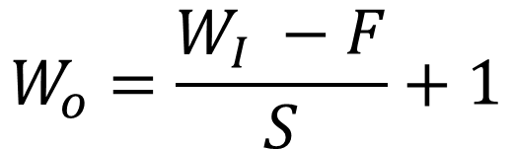
Pooling layer
Parameters
Filter size (spatial extent): F
Stride: S
Input: W_{I} × H_{I} × D
Output: W_{O} × H_{i} × D
It has no learnable parameters
$$W_{o}=\frac{W_{I} −F}{S}+1$$
$$H_{o}=\frac{H_{I} −F}{S}+1$$

Slide 34
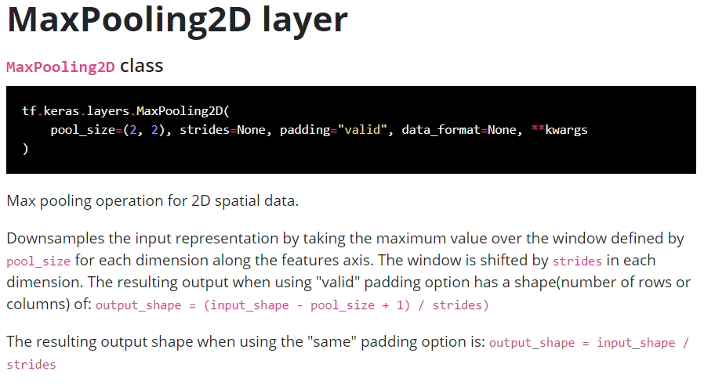
AveragePooling2D

Slide 35
Fully connected layers
They don’t preserve spatial information
Linear unit followed by a linearity
Just in regular NN, contain several neurons that are connected to the entire input volume
Each neuron “sees” the entire input volume
f(W·X + b)
1
1
f – activation function
W – weight matrix (D_{O} × D_{I})
b – bias vector
D_{I}
D_{O}

Slide 36
If we have an input volume of 27x27x5, what will be size of this volume if we apply a padding of 2?
How many parameters (including the bias) does a convolutional layer with 10 filters of size 5x5 have?
How many parameters (including the bias) does a convolutional layer with 10 filters of size 5x5 have if the input size is 32x32x3? What if we use a stride of 2?
Given an input volume that is 63x63x16 that is convolved with 32 filters that are each 7x7, using a stride of 2 and no padding. What is the output volume?
Given a RGB image of size 300x300, and you use a classical neural network with the first hidden layer of 100 neurons (each one fully connected to the input). How many parameters does this hidden layer have?

Slide 37
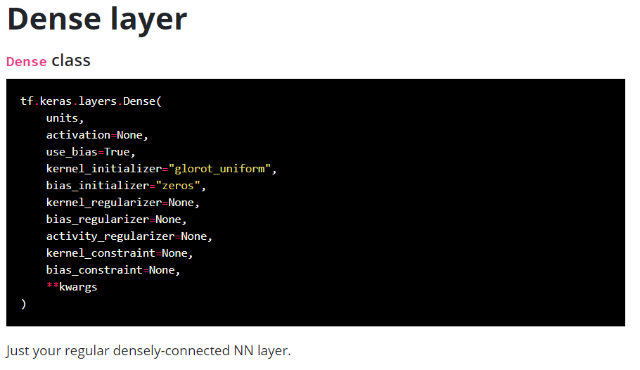

Slide 38

Typical neural network architecture
Image source: https://medium.com/@RaghavPrabhu/understanding-of-convolutional-neural-network-cnn-deep-learning-99760835f148

Slide 39
Typical neural network architecture
Several CONV, POOL and FC layers stacked together
[CONV-ReLU-POOL]*N – [FC]*K – softmax
Recent neural networks change this paradigm
The trend is to reduce the filter sizes and to increase the depth of the networks
Another trend is to avoid using POOL and FC layers, and use only CONV layers

Slide 40
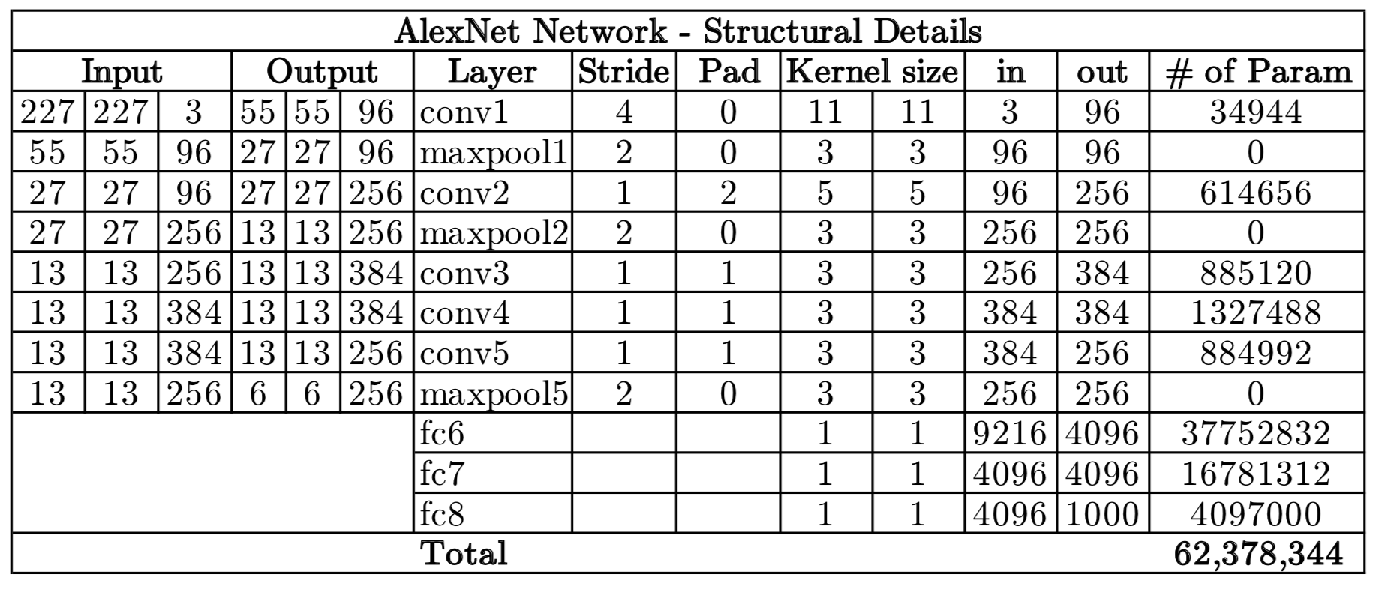
Alexnet example
“AlexNet input starts with 227 by 227 by 3 images. And if you read the paper, the paper refers to 224 by 224 by 3 images. But if you look at the numbers, I think that the numbers make sense only of actually 227 by 227.”

Slide 41
Playground
https://cs.stanford.edu/people/karpathy/convnetjs/demo/mnist.html

Slide 42
Learning from multiple tasks
Transfer learning
Task A and task B have the same input
More data for task A than for task B
Low level features from task A could be helpful for learning task B
Multi task learning
Training on a set of tasks that could benefit from having shared low level features
Amount of data for each task is quite similar. Can train a big enough network to do well on all the tasks.

Slide 43
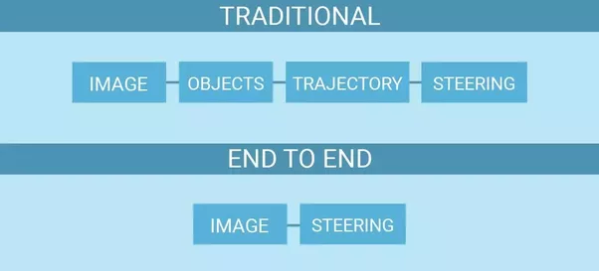
End to end deep learning
Advantages:
Lets the data speak
No handcrafted features
Disadvantages
Needs huge amount of data
Excludes potentially useful hand-designed components

Slide 44
Data pre-processing

Slide 45
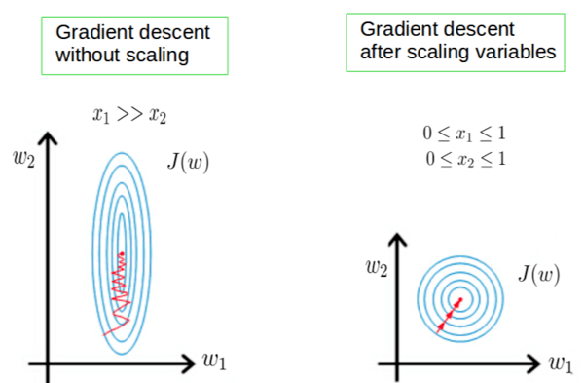
Importance of feature scaling

Slide 46
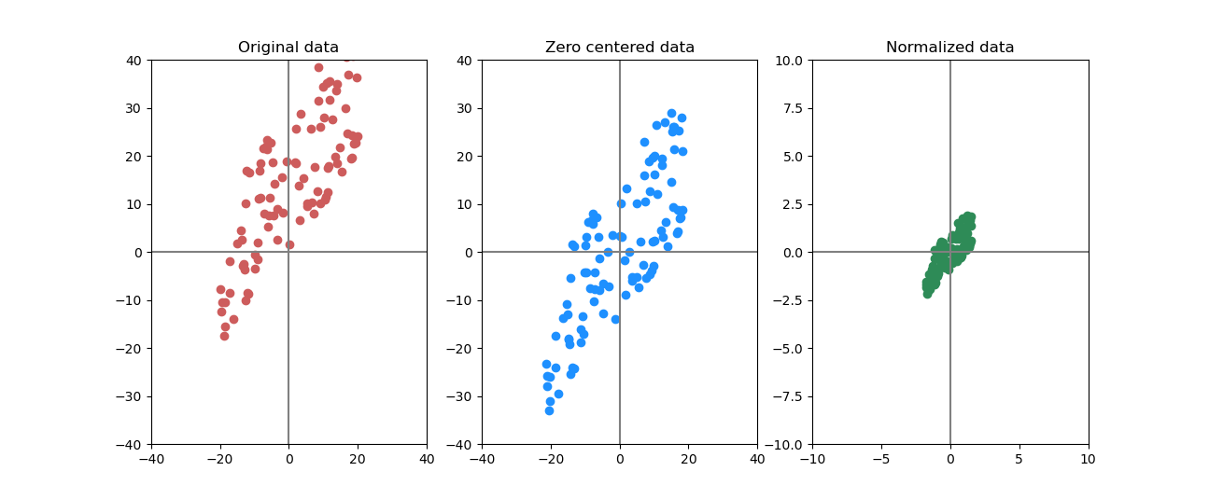
Mean subtraction, scaling
X
X -= np.mean(X, axis=0)
X /= np.std(X, axis=0)

Slide 47
Pre-processing for Images
Zero center: subtract the mean across every individual feature in the data
Mean image
Mean across each channel
Optional: normalize the data such that dimensions are approximately the same scale
https://github.com/keras-team/keras-applications/blob/master/keras_applications/imagenet_utils.py

